Slide 1
Crime Analysis through Machine Learning
Presented by
Mohammad Ayyaz Azeem
CMS 32175

Slide 2
INTRODUCTION
Dataset
Steps taken
Procedure/Steps taken

Slide 3
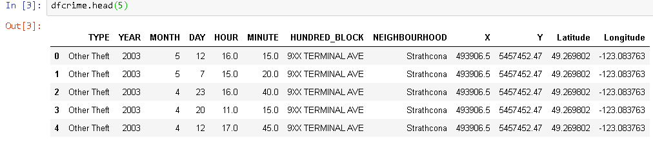
DATASET EXPLANATION
560,000 records
Vancouver Police Department crimes dataset [2003-2017]
https://vancouver.ca/police/

Slide 4
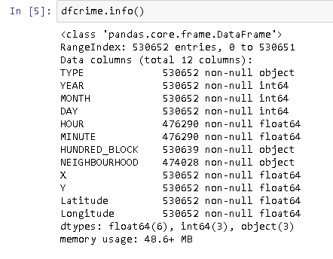
Data overview

Slide 5
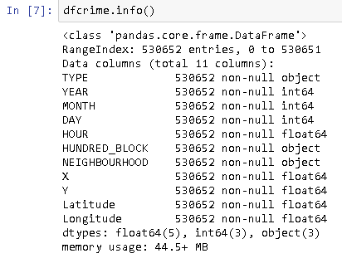
Handling Missing Values

Slide 6
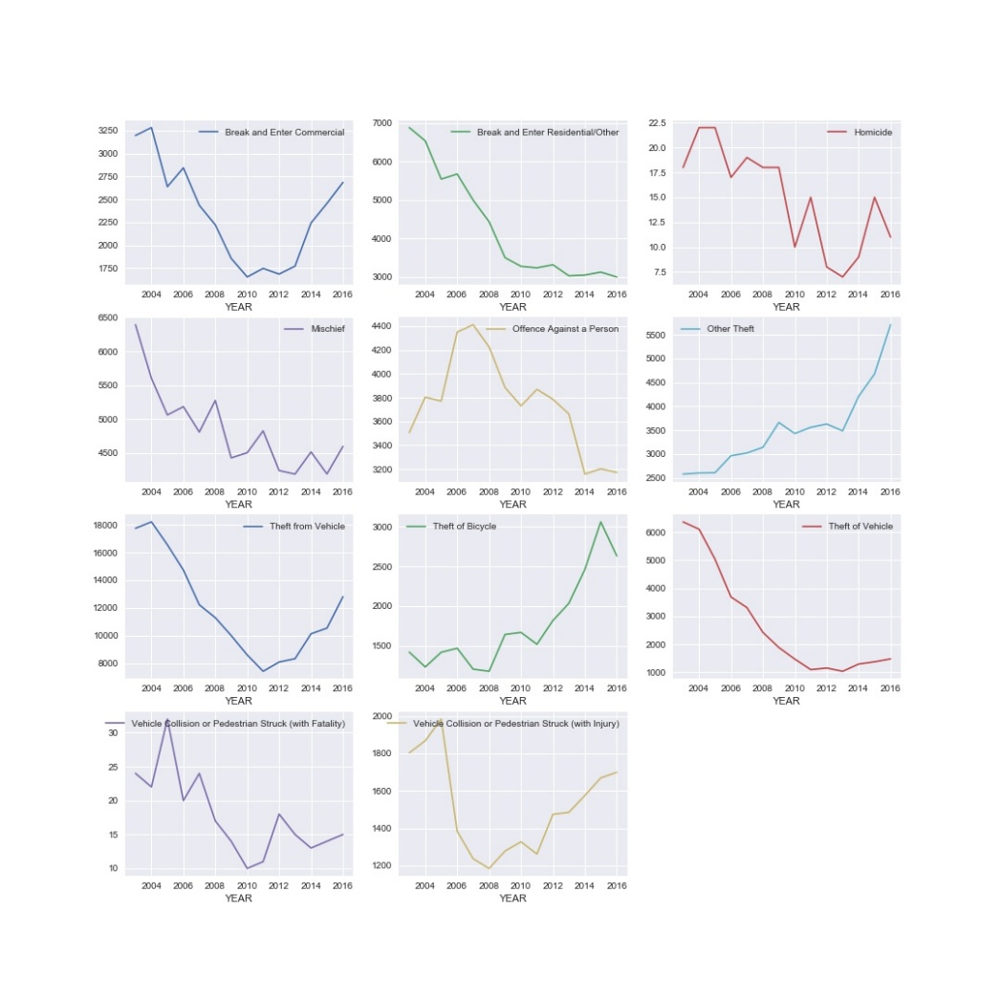
Crime Types yearly analysis

Slide 7
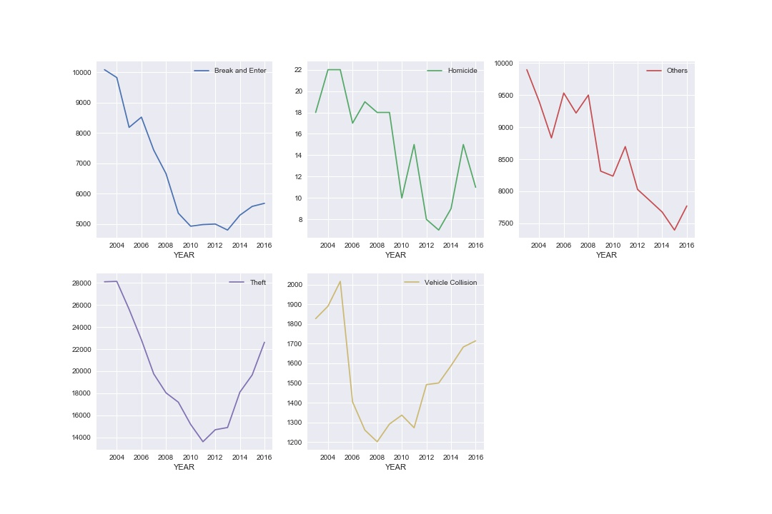
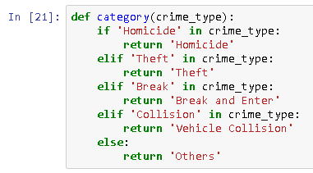
Category wise yearly analysis

Slide 8
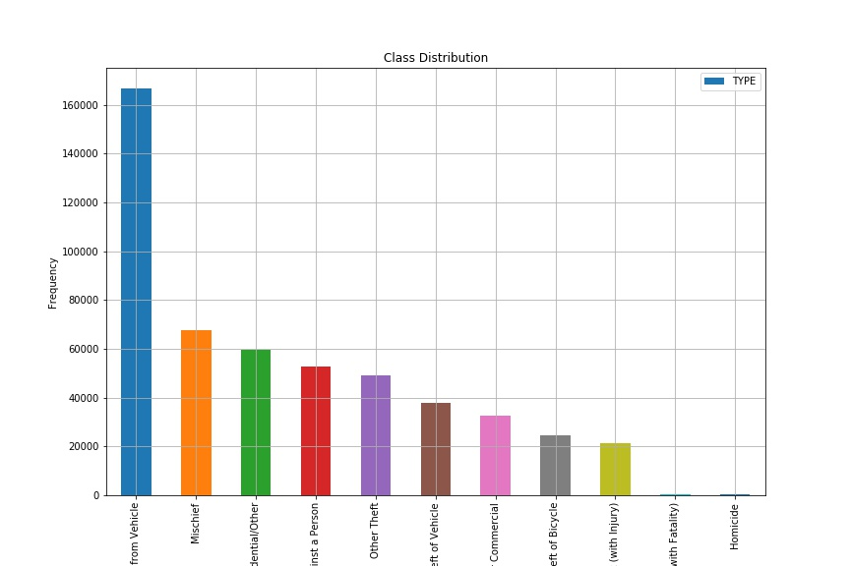
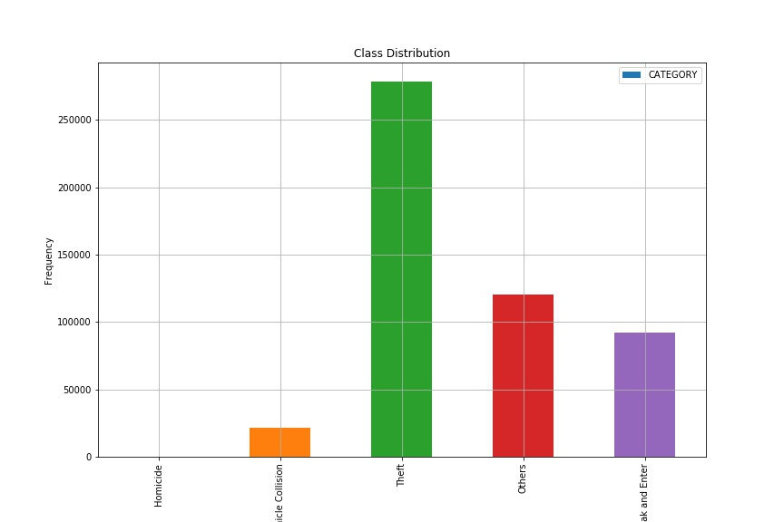
Crimes by Types
Crimes by Category

Slide 9
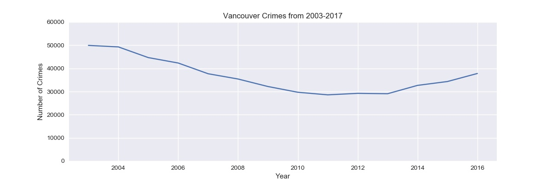
Number of Crimes Pattern/Trend

Slide 10
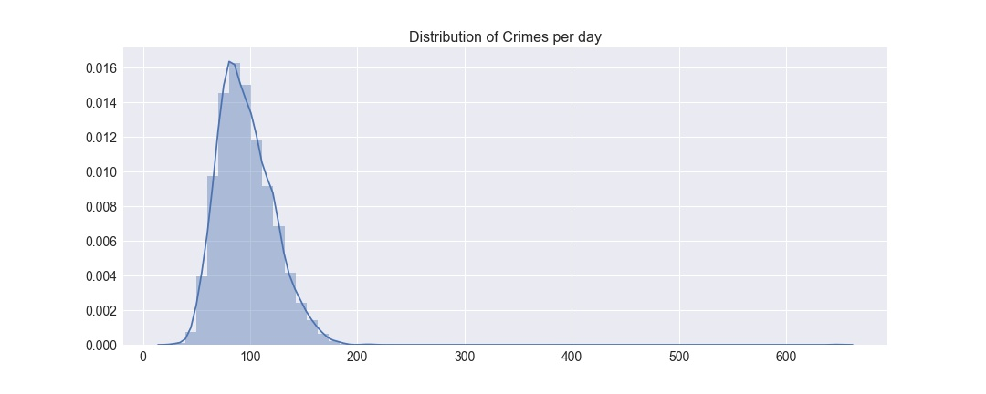
Crimes Distribution Per Day

Slide 11
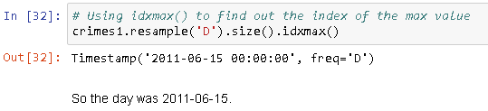
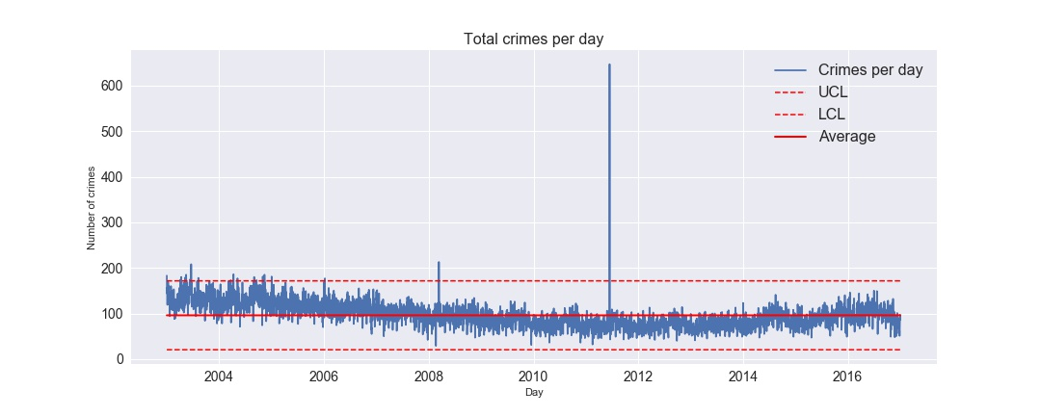
Crimes Per day

Slide 12
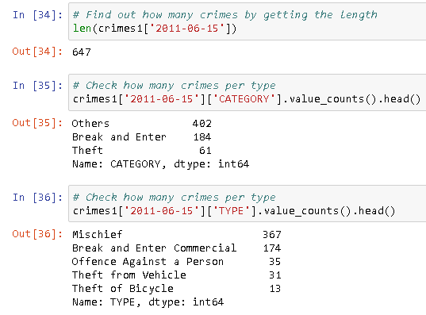
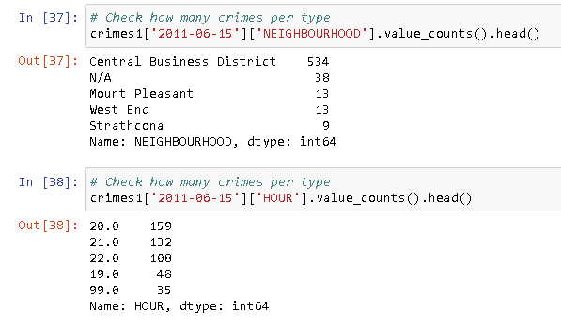
Outlier
There are 647 occurrences, mostly mischief type, in Central Business District, around 20:00-22:00.

Slide 13
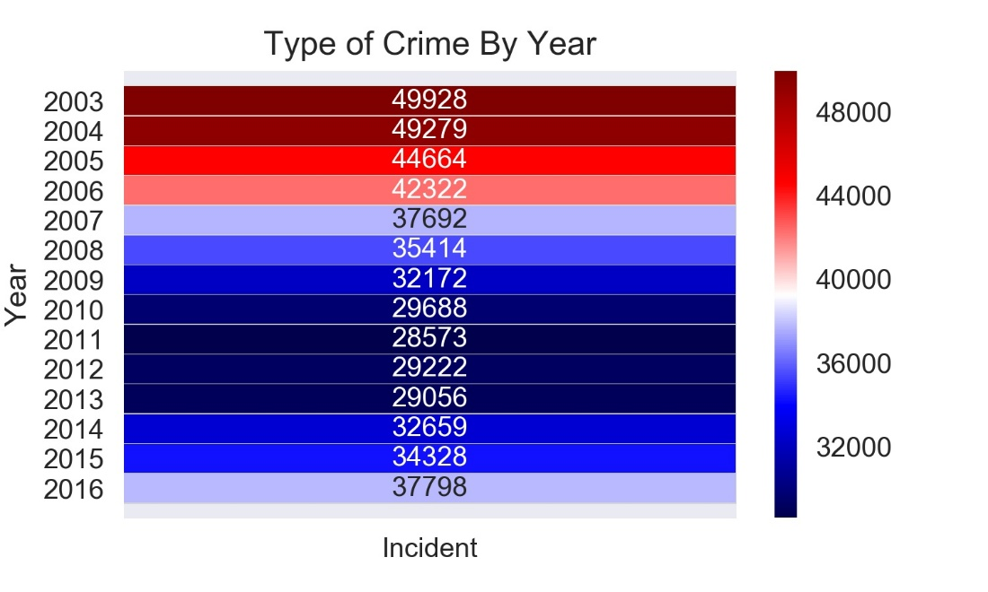
Crimes By Year
Findings: Initial Year from 2003-2006 were the worst in case of crimes

Slide 14
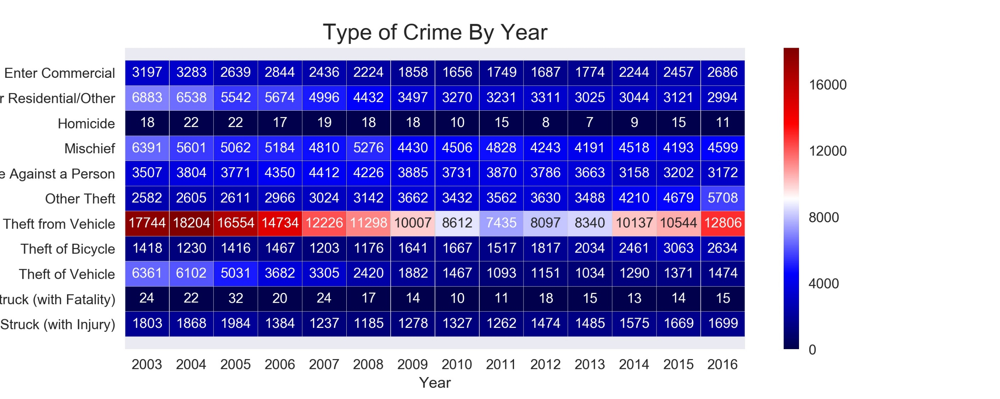
Crimes By Year By Type
Findings:
1. Theft from Vehicle are the worst kind of crime.
2. Least occurring crimes are 'Homicide' and 'Vehicle Collision(with Fatality)'

Slide 15
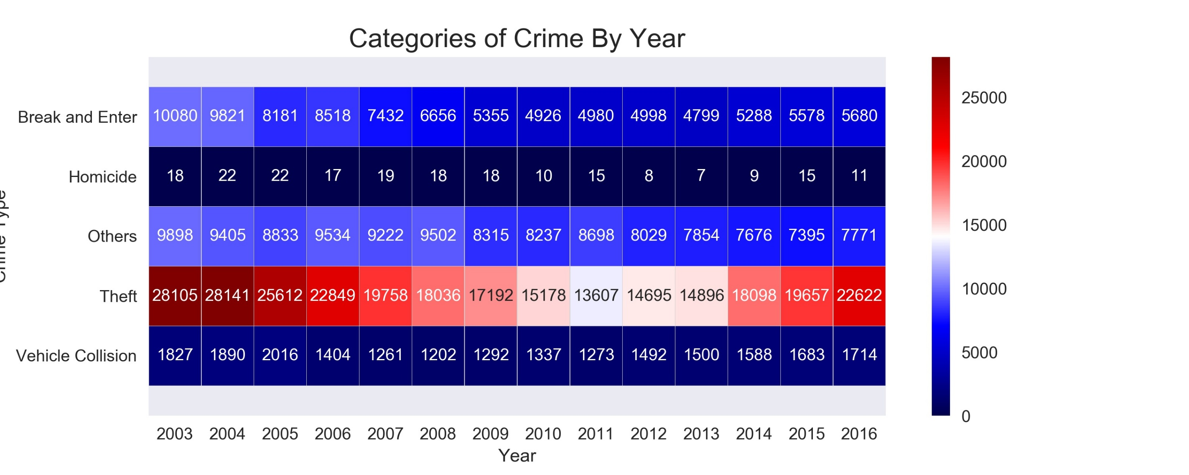
Crimes By Year By Categories
Findings:
1. Theft is the most occurring Crime
2. Homicide is the least occurring Crime

Slide 16
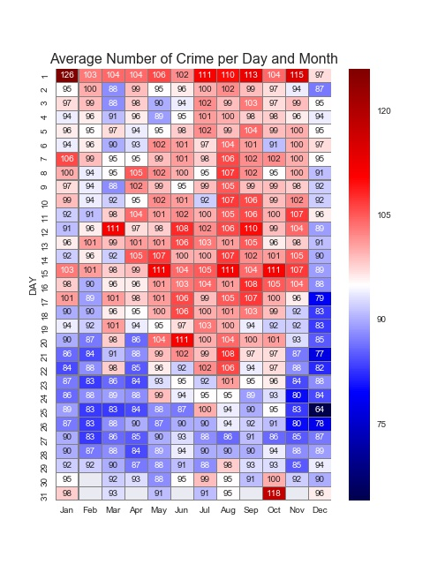
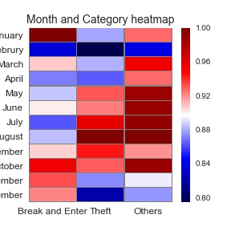
Findings:
Blue means good days. Red means bad days. White average days.
The Calmest day of crime is Christmas Day. December 25(30% below average).
The worst day is New Year's Day, January 1 and October 30-November 1 (Halloween).
The first day of the month is a busy day for all month.

Slide 17
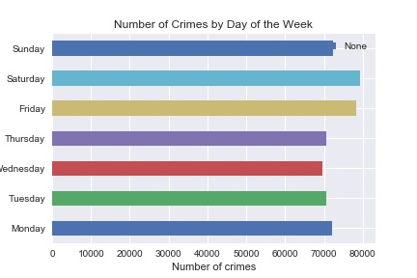
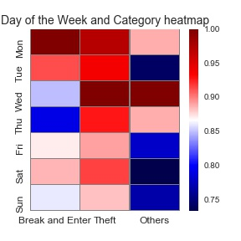
Number of Crimes by Day of the Week
Findings: Weekend +Friday are most prone to Crimes

Slide 18
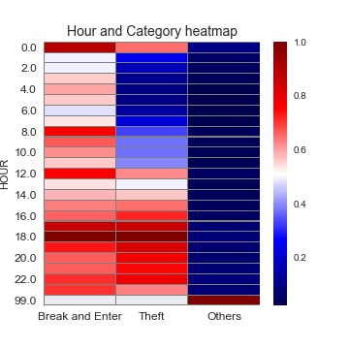
What hours do crime happen?
Findings
Most crimes happen between 17:00-01:00
Category Others doesn't have Hours mentioned in the dataset in most cases

Slide 19
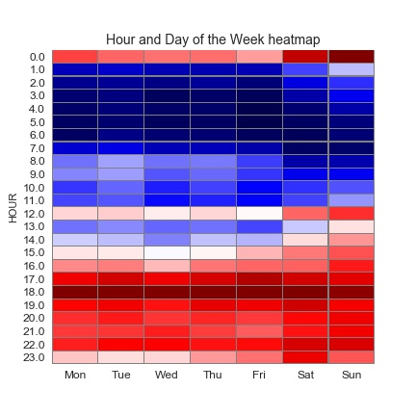
Do Crimes happen in the same hour for each day of the week?
Findings
on Weekends: the crimes activity starts at 15:00-00 peaks at 17:00-23:00
on weekdays: the crimes activity starts at 16-00:00 peaks at 17:00-22:00

Slide 20
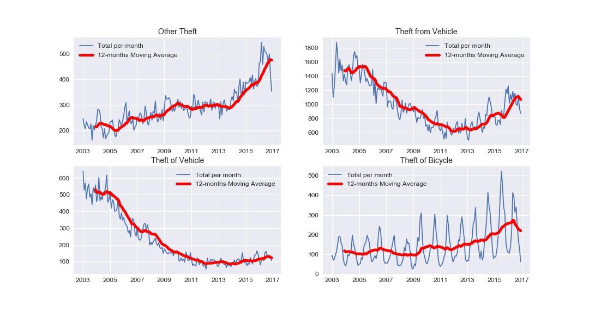
Each type of crimes general trend

Slide 21
Findings
Other Theft
1. This trend has been increasing. from around 200 to almost 500 crimes per month.
Theft from Vehicle
1. it is the most frequent type of crime.
2. This trend has been decreasing till 2012 from 1600 to 600 and then it has increased to 1200 in 2017.
Theft of Vehicle
1. this crime has decreased from 600ish to almost 100
Theft of Bicycle
1. we can see the trend from graph that this crimes peak during the mid of year: summer.
2. The average has also been increasing.

Slide 22
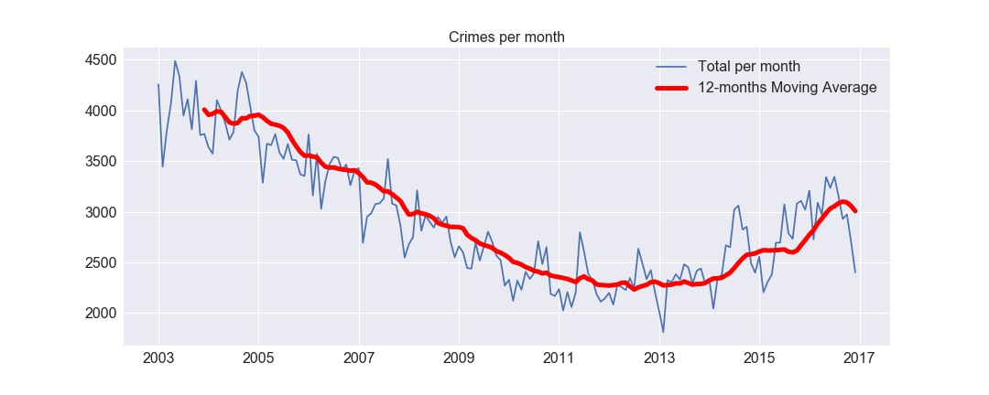
Is the Crime decreasing or increasing-Year/Month
From 2003 to 2011 the average number of crimes per month decreased from 4000 crimes per month to arround 2400.
From 2011 to 2014, the moving average was around the same.
From 2014 to 2015 the average has increased.
From 2016 reached similar levels of 2008

Slide 23
Moving average Crimes Per Day Data

Slide 24
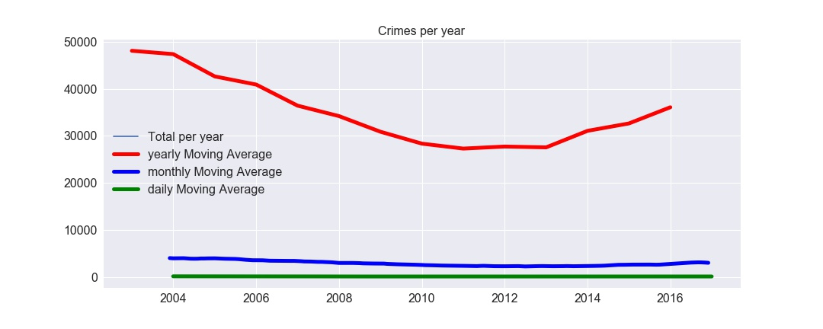
Moving average Crimes Data (Year/Month/Day)

Slide 25
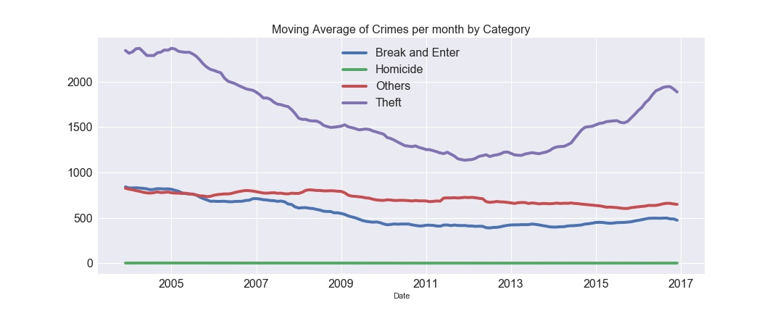
Is the trend the same for all categories?
Findings: Theft is the major category.
The decrease and increase that we saw in the average number of crimes per month was mainly because of the variations in this category.

Slide 26
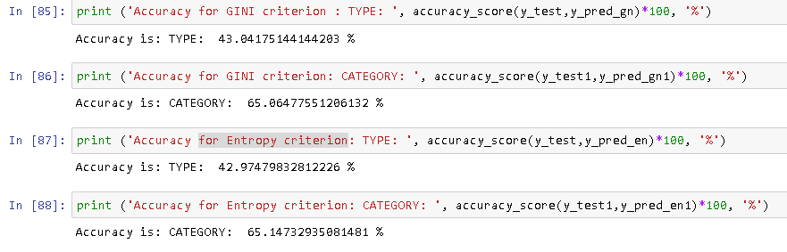
PROCEDURE/TECHNIQUES USED
Decision Tree Classifier Applied

